Slide 1





Lesson 1
Getting to know a spreadsheet

Slide 2

Learning Objectives
1
Identify columns, rows, cells, and cell references within spreadsheet software.
2
Use formatting techniques in a spreadsheet

Slide 3

Starter activity
Hogwarts Express Tea Trolley– who ordered what?
Answer the questions on the sheet.

Slide 4

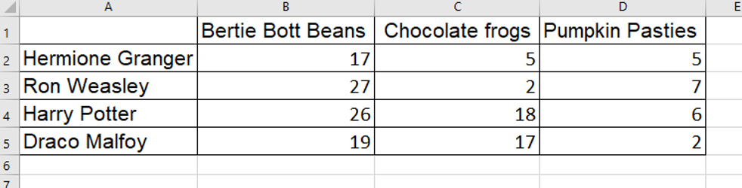

Was the data easy to work with?
How could we organise it to make it better?

Slide 5


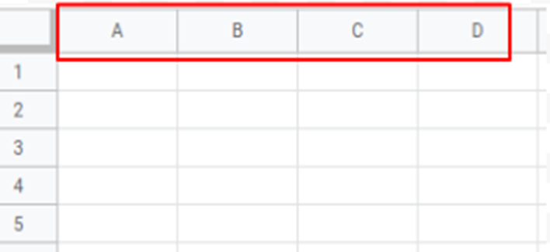
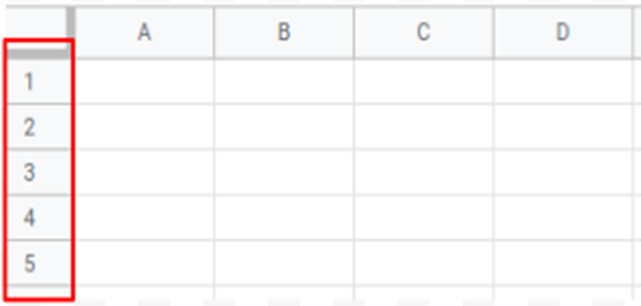
Cell referencing
Cells are spaces that hold data
A cell reference tells you the location of a cell and is made up of:
The column name
The row number

Slide 6
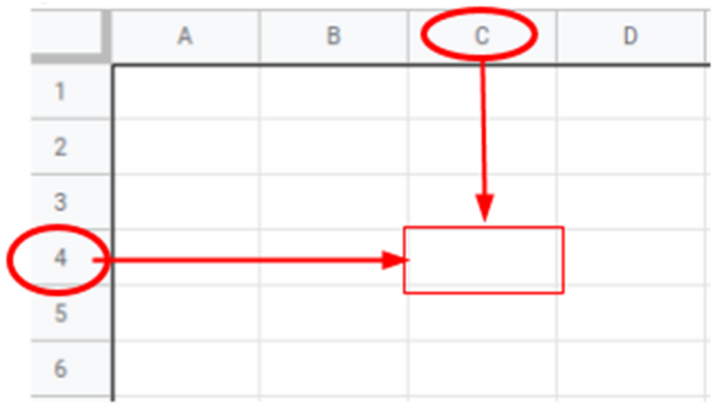
Cell referencing
Cells are spaces that hold data
A cell reference tells you the location of a cell and is made up of:
The column name
The row number

Slide 7
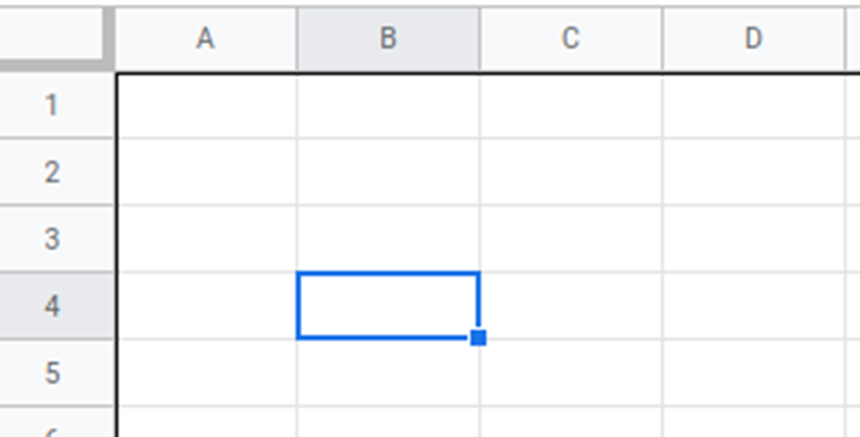
Cell referencing
What cell is this?

Slide 8
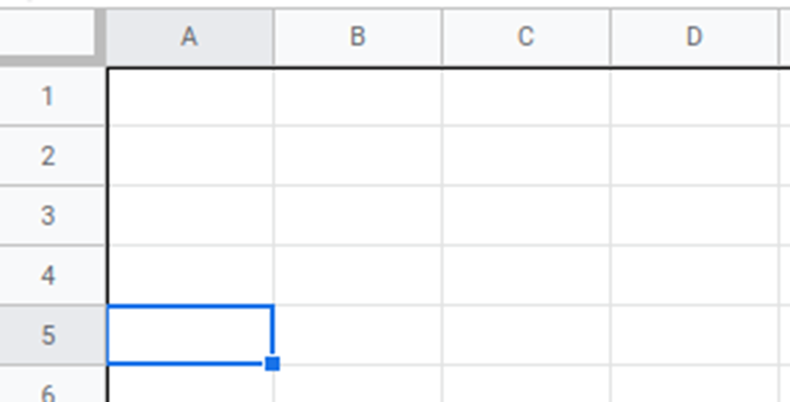
Cell referencing
What cell is this?

Slide 9
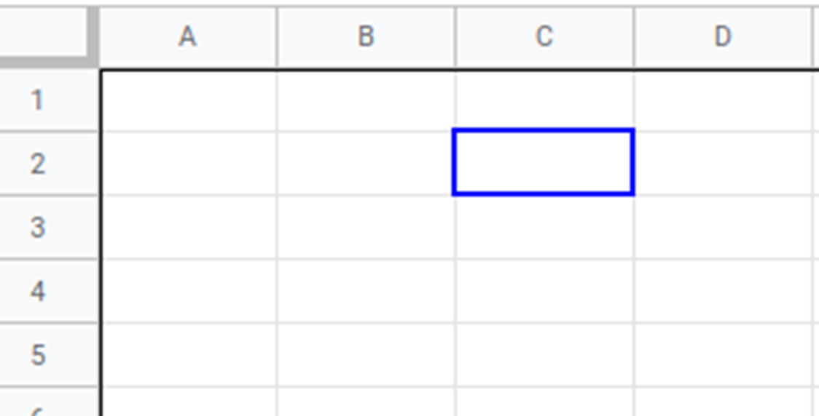
Cell referencing
What cell is this?

Slide 10


Activity 1 - Wizards Challenge
1
When I say “go,” type your name.
2
Use the column letters and the row numbers to give each cell a reference (or cell address) and type its correct reference in the cell.
3
Use the Tab key to move to the next cell, even at the end of a row.
4
Type quickly because you will be timed.
Correct answers will turn the cell green.
5
When I say “stop,” check your score.

Slide 11

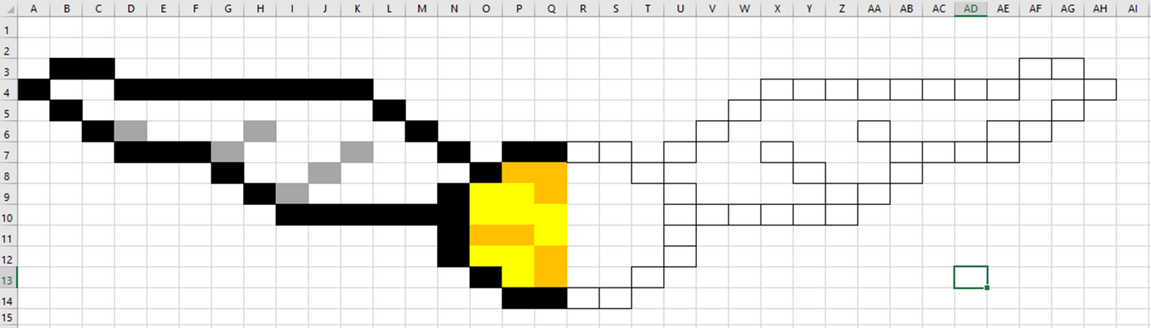
Activity 2 -Pixel Art - Can you complete the Golden Snitch?

Slide 12
Test your knowledge
Row, column or cell?
In the following images, different parts of a spreadsheet are highlighted. Can you identify them

Slide 13


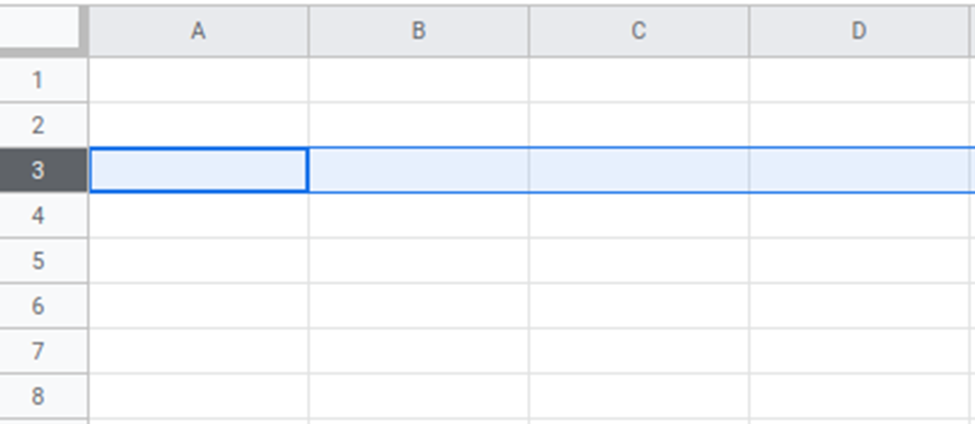
Row, Column or Cell?

Slide 14

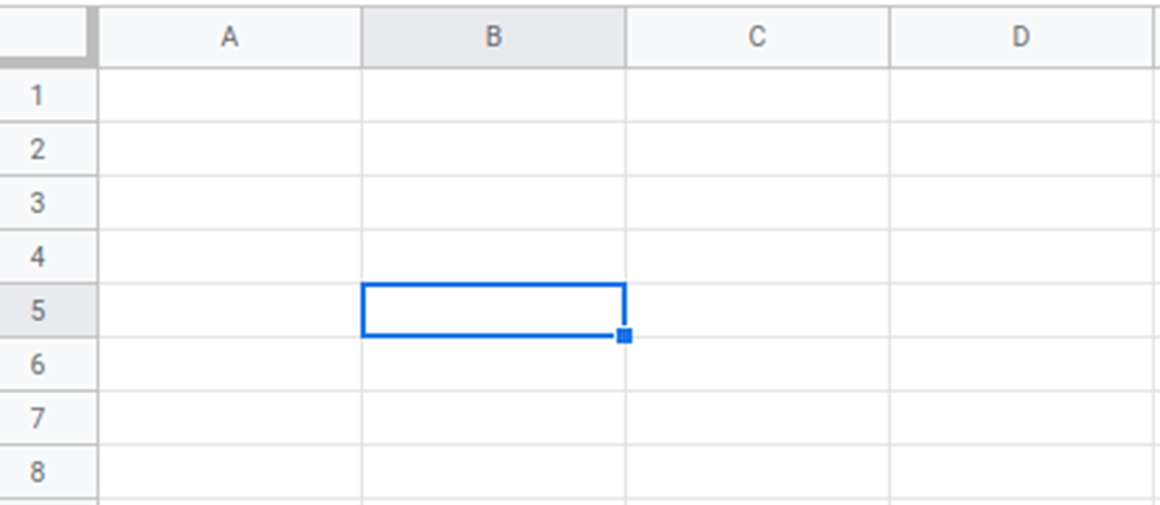
Row, Column or Cell?

Slide 15

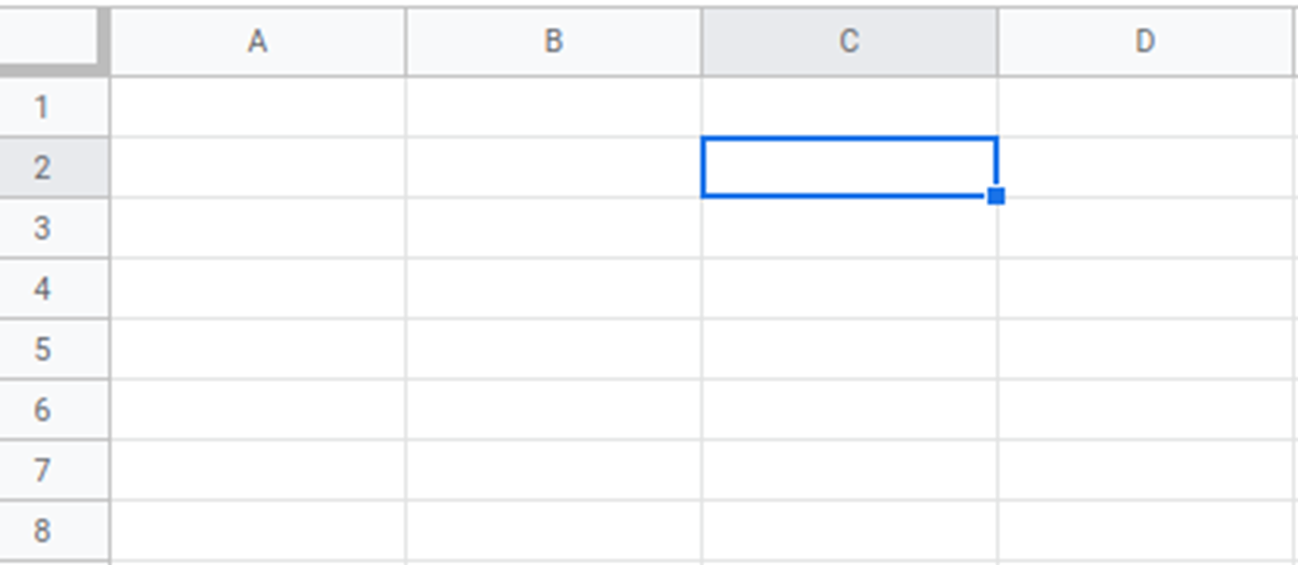
Row, Column or Cell?

Slide 16
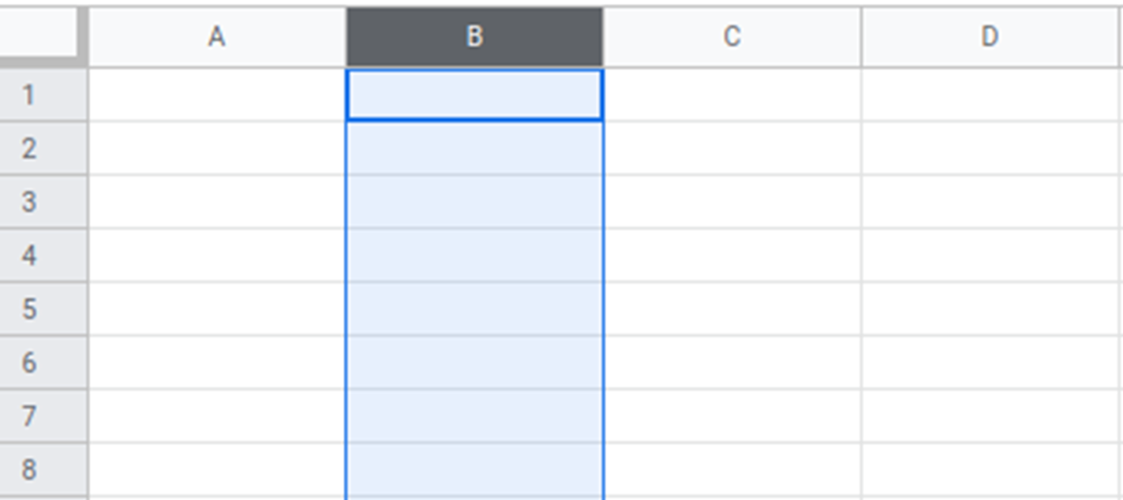
Row, Column or Cell?

Slide 17
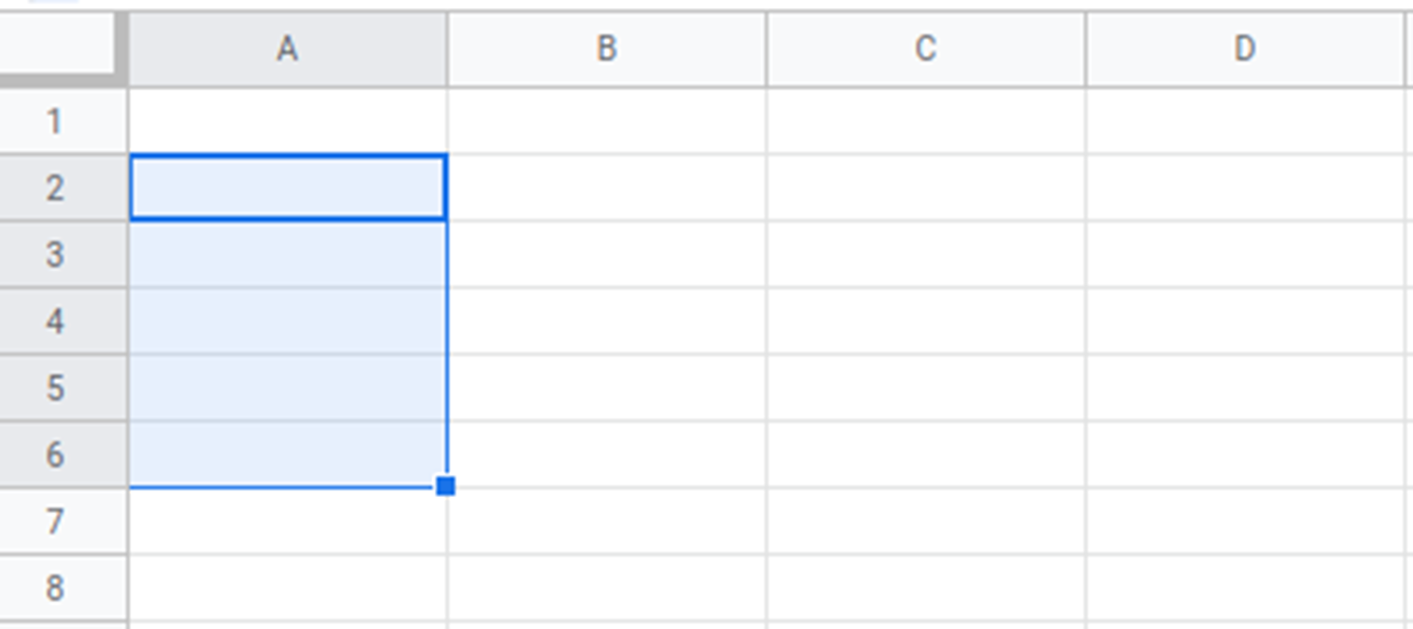
NAme the range

Slide 18
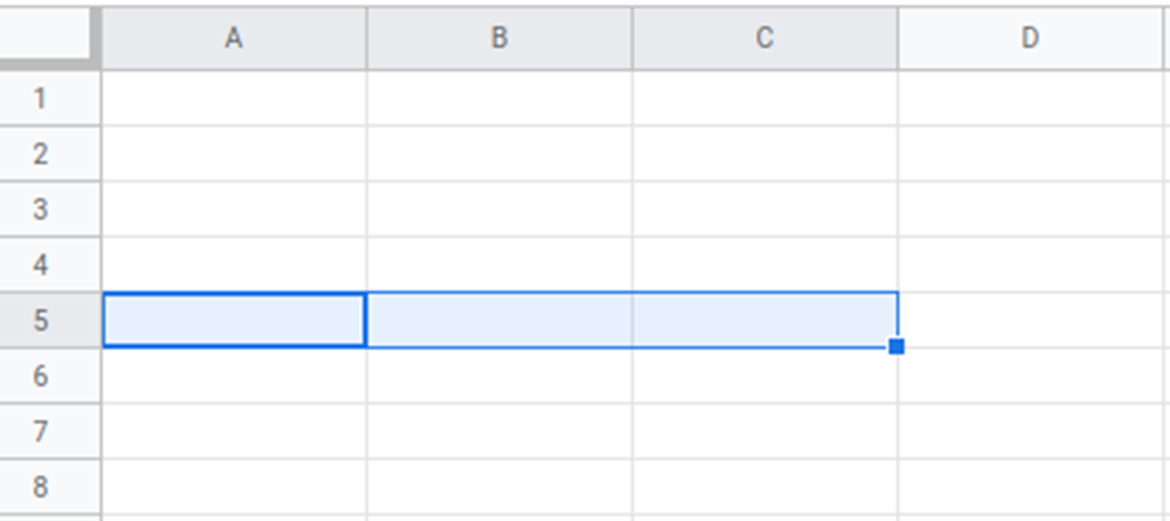
NAme the range

Slide 19
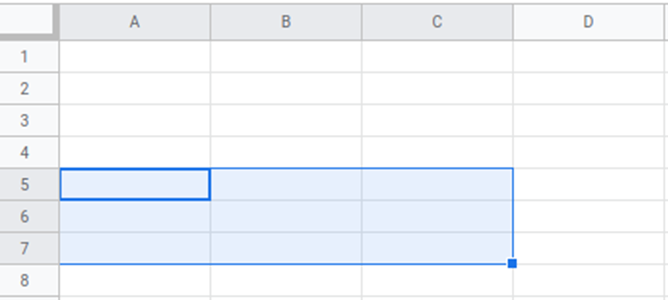
NAme the range

